Slide 1
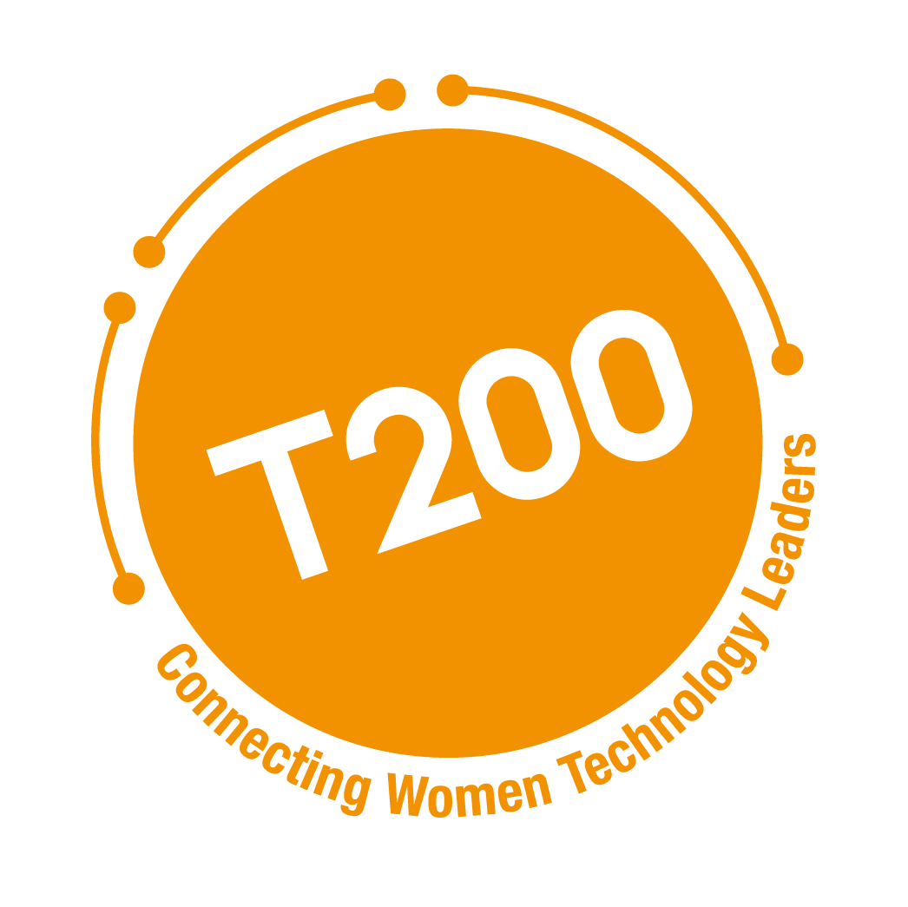
T200 AI Leadership and Governance
Lead with Responsible AI
T200 AI Leadership & Governance Series | 2026 www.t200.org

Slide 2






ABOUT T200
A Global Community of Senior Technology Executives
T200 connects women leaders across industries to share experience, strengthen leadership capability, and support advancement into CIO, CTO, and C-suite roles.
Curated Programs
Peer Exchange
Mentorship
Executive-level convenings on the imperatives shaping enterprise AI and technology leadership.
Trusted dialogue across industries, functions, and stages of leadership.
Guidance and sponsorship pathways into CIO, CTO,CAIO next level roles.
ABOUT T200 AI GOVERNANCE & LEADERSHIP COUNCIL
Suja Chandrasekaran
Chief Operating Officer | Chief Technology and AI Officer | Public and Private Board Director
Pooja Dewan, Ph.D
CDO, Rentokil Terminix
CTO | CDO | CDAO | Advisory | Board Member | Manufacturing | Logistics
Jyoti Wadhwa
Fmr. Global Head, Product & Cloud Security, NetApp
AI Governance Executive & Board Advisor | CISSP
Priya Raman
Head-Data & AI, Apple
Board Director | Enterprise AI & Decision Intelligence
Deepika Rayala
CDIO
Enterprise AI, Digital Transformation & Risk Leadership
Hsing Hsing Li
COO
ACELER8.AI
AI & Enterprise Transformation Leadership
T200 AI Leadership & Governance Series | 2026 www.t200.org
11

Slide 3
SPOTLIGHT SERIES | 2026
T200 AI Leadership & Governance Series
Equipping Executive Leaders to Scale AI with Accountability & Value
AI is scaling rapidly across the enterprise, and leadership demands are scaling faster. Organizations are moving from experimentation to operational deployment while governance, ownership models, and value discipline are still catching up.
FIVE LEADERSHIP IMPERATIVES
Each imperative will be explored through focused executive sessions.
01
02
03
04
05
Lead with Responsible AI
AI Impact and Driving Outcomes
The AI Operating Model
Operationalize the AI Lifecycle
Vendors & Partners
The AI Trust Imperative
Quantifying AI's P&L Impact from Hypothesis to Profit
People Readiness Lessons for Architecting the AI-Native Organization
Manage platforms, and AI capability design, develop, test, operate with the higher rigor.
Why partnerships are crucial for enterprise AI to scale, and how to select the right partners across the value chain.
T200 AI Leadership & Governance Series | 2026 www.t200.org
1

Slide 4
Poll: Are responsible AI and governance practices established in your organization?

Slide 5
The AI Governance Gap Is Impacting Organizations
Adoption is accelerating. Governance readiness is not keeping pace. The costs are no longer hypothetical.
50%
60%
73%
of CIOs
of brands
of executives
lack confidence in their ability to execute against agentic AI priorities
will use Agentic AI for customer interactions by 2028
expect their agentic AI projects to deliver value within 12 months
Source: Gartner, 2026
Source: Gartner, Jan 2026
Source: KPMG AI Pulse Survey, Q3 2025
CYBERSECURITY THREAT | Mythos AI, 2026
Advanced AI model with autonomous offensive cyber capabilities — a wake-up call that AI is now an active part of the enterprise attack surface, not just a productivity tool.
Cause: AI capabilities outpacing security governance frameworks
Anthropic Project Glasswing, 2026
T200 AI Leadership & Governance Series | 2026 www.t200.org
www.t200.org

Slide 6
T200 SPOTLIGHT SERIES 1
OBJECTIVE
Equip leaders to govern AI-driven decisions with confidence, embedding oversight, ownership, and lifecycle controls before scale creates unmanaged enterprise risk.
Lead with
Responsible
AI
Enabling confident AI scaling in the enterprise.
WHY IT MATTERS NOW
■ AI is now shaping decisions, not just automating tasks: impacting operations, customers, and financial outcomes.
■ Risk has evolved from system (cyber) and data (info) risk to decision risk affecting compliance, reputation, and performance.
■ Regulatory and stakeholder expectations are accelerating, requiring demonstrable control and transparency.
WHAT IT ENABLES
■ Elevates AI governance to a board-level priority.
■ Align Technology, Risk, Legal, and Business leaders on clear accountability.
■ Scale innovation while maintaining operational control and institutional trust.
JUNE 11 2026
PRACTICAL TAKEAWAYS
■ The risk and regulatory drivers making governance non-optional
■ Where AI technology risk originates across modern architectures
■ A practical four-step governance implementation model
T200 AI Leadership & Governance Series | 2026 www.t200.org
Lead with Responsible AI | May 7, 2026
2
Notes:
EVERYTHING IS NOT AI
EVERYTHING WILL NOT BE AI
BUT CERTAINLY AI IS EVERYWHERE
ARE ANSWERS RIGHT
DATA PROVENANCE AND LINEAGE; DO WE HAVE A LINE OF SIGHT TO SOURCES AND DEFINITIONS OF DATA ; DATA STANDARDS BEEN APPLIED CONSISTENTLY
CYBER IMPACT; AI FOR CYBER AND CYBER FOR AI
GOVERNING : TRUSTED AI GOVERNANCE VS RESPONSIBLE AI ; NESTED
TRUSTED AI GOVERNANCE
IN THE WORLD OF DIGITAL WE USED TO HAVE THE SAYING: FAIL FAST; BREAL THINGS; THERE IS NO FAIL FAST HERE; AS ITS NOT JUST BAD FEATURE FUNCTIONS IN YOUR PRODUCTS; BUT IT IS JUST ERRONEOUS OUPUTS ;
PHYSICAL AI PUTS AI IN WAREHOUSE, MANUFACTURING PLANT
Cross functional councils
General council
Privacy and compliance officers
Internal Audit
Tech teams; data teams
Cyber
Business orgs

Slide 7
Poll: How familiar are you with AI Governance?

Slide 8
JUNE 11, 2026 | LEAD WITH RESPONSIBLE AI: THE AI TRUST IMPERATIVE
Four Topics Frame the Session
A practical walkthrough of responsible AI and governance: from principles, to risk, to controls, to implementation.
01
FOUNDATIONS & PRINCIPLES
02
RISK & REGULATORY LANDSCAPE
What Are Responsible AI
and AI Governance?
What is Driving AI
Governance
Understanding the distinction between responsible AI outcomes and the governance mechanisms used to achieve them.
Understanding the business, regulatory, and technology risks driving governance requirements.
03
AI RISK IN PRACTICE
04
IMPLEMENTATION & OVERSIGHT
Where AI Risk
Comes From
A Practical
Governance Approach
Exploring modern AI architectures and where data, model, runtime, agentic, and decision risks emerge.
Applying discovery, governance, controls, and monitoring to establish trusted AI operations.
The four-step model: Discover → Govern → Control → Monitor
T200 AI Leadership & Governance Series | 2026 www.t200.org
T200 AI Leadership & Governance Series | 2026
www.t200.org
Notes:
SPEAKER NOTES — FOUR TOPICS FRAME THE SESSION This slide orients the audience. Walk each topic in 20-30 seconds. Suggested script: "We are covering four topics today, and they build on each other deliberately. First, we will establish what Responsible AI and AI Governance actually mean — because those terms get used interchangeably, and they should not be. Second, we will look at why governance is emerging now — the regulatory and business forces making this non-optional. Third, we will get specific about where AI risk actually comes from. Not theoretical risk. The concrete places in an AI system where things go wrong. And fourth, I will walk you through a practical four-step approach your organization can implement, regardless of where you are today." Transition: "Let us start with Topic 1." MODERATOR GUIDE: Primary Q1: Before we begin, a quick show of hands — how many of you already have a formal AI governance program in place? Primary Q2: What is the most pressing AI governance question in your organization right now? Follow-up: What is holding your organization back from moving faster on governance? Follow-up: How are you currently managing shadow AI — the tools employees are already using without formal approval?

Slide 9
TOPIC 1 OF 4 | FOUNDATIONS & PRINCIPLES
What Are Responsible AI and AI Governance?
Responsible AI defines the outcomes. AI Governance establishes the operating model to achieve them.
Defines
Operates
AI LIFECYCLE*
RESPONSIBLE AI
AI GOVERNANCE
The outcomes we want AI systems to achieve
Plan &
Design
Collect &
Process
Build & Use
Model
Verify &
Validate
Deploy
& Use
Operate
& Monitor
People
& Planet
The operating model used to achieve those outcomes
Scope, purpose,
impact assess.,
stakeholders
Internal &
external
validation
Model
testing
Model
testing
Integration,
compliance
testing & val.
Audit &
impact
assessment
Audit &
impact
assessment
• Policies and decision rights
• Fair and unbiased
• Transparent and explainable
• Roles and accountability structures
GOVERNANCE REQUIREMENT AT EACH STAGE
• Risk management processes
• Accountable to stakeholders
Risk
Assessment
Data
Governance
Model Risk
& Cards
Validation
& Approval
Runtime
Controls
Continuous
Monitoring
Impact
Assessment
• Lifecycle controls
• Privacy-preserving
• Safe and secure
Use-case review,
scope &
classification
Classification,
lineage &
consent
Bias testing,
explainability
review
HITL gate,
sign-off before
production
Prompt inject.,
drift & output
monitoring
KRIs, audit
readiness &
evidence
Harm review,
stakeholder
reporting
• Monitoring and reporting
• Reliable and robust
• Continuous improvement
*Source: NIST AI RMF 1.0
T200 AI Leadership & Governance Series | 2026 www.t200.org

Slide 10
THE REGULATORY MAZE
Mapping the Patchwork of Frameworks, Regulations, Principles and Guidelines
A fragmented landscape spans jurisdictions, sectors, and instrument types. Effective governance requires a working map of where laws, frameworks, and standards converge and diverge.
JURISDICTIONS
DATA & PRIVACY LAWS
INDUSTRY RULES
FRAMEWORKS & STANDARDS
SECURITY MAPS
Geographic regimes
Foundational and adjacent
Sector-specific obligations
Voluntary for now
Threat-side guidance
■ EU: European Comm.
■ US: state laws, federal sector rules
■ UK: pro-innovation framework
■ China: generative AI measures
■ Singapore AI Verify, Japan, Canada AIDA
■ OECD AI PRINCIPLES
■ EU AI Act, GDPR
■ State Laws (CCPA/CPRA, Utah, Texas, NY, Colorado)
■ HIPAA (health), GLBA (finance)
■ Sectoral data localization rules
■ Automated decision-making provisions
■ Cross-border transfer
■ Healthcare: FDA, HHS guidance
■ Financial services: SR 11-7, FFIEC, OCC
■ Insurance: NAIC AI principles
■ Employment: EEOC bias guidance
■ Consumer protection: FTC enforcement
■ Industry IP Protections
■ NIST AI RMF
■ CSA TAISE
■ ISO/IEC 42001
■ AIUC-1
■ Databricks RAI Framework
■ Industry-specific RAI playbooks
■ Vendor Frameworks (Google, AWS, …
■ MITRE ATLAS
■ OWASP AI Exchange
■ NIST CSF (AI extensions)
■ AI Incident Database
■ ML-BOM and supply chain norms
■ Red-team protocols
GOVERNANCE TAKEAWAY: No single regime is sufficient. Enterprise AI compliance requires a layered map across all five categories.
T200 AI Leadership & Governance Series | 2026 www.t200.org
Lead with Responsible AI | May 7, 2026
5
Notes:
Who is going to build the expertise; how will the cros
9 distinct frameworks/ family of frameworks
33 distinct laws and guidelines
3 distinct set of principles
NIST AIRMMF has 4 core functions and 72 categories that serve as control objectives; each category could become one or more controls;
GOVERN (19 subcategories): Focuses on cultivating a culture of risk management. It includes 6 main categories, such as establishing policies, accountability structures, workforce diversity, organizational culture, stakeholder engagement, and third-party data management. For example, subcategory GOVERN 1.4 specifically requires that risk management outcomes are established through "transparent policies, procedures, and other controls" based on organizational risk priorities.
MAP (18 subcategories): Focuses on recognizing context and identifying risks. It includes 5 main categories covering context establishment, AI system categorization, capabilities and benefits analysis, component risk mapping, and impact characterization.
MEASURE (22 subcategories): Focuses on assessing, analyzing, and tracking identified risks. It includes 4 main categories: identifying methods and metrics, evaluating trustworthiness (which alone contains 13 specific subcategories like assessing safety, fairness, and privacy), tracking risks, and gathering measurement feedback.
MANAGE (13 subcategories): Focuses on prioritizing and acting upon risks based on projected impact. It includes 4 main categories encompassing risk prioritization and response, impact strategies, third-party management, and response planning and monitoring
Here is the breakdown of the frameworks, country-specific laws/guidelines, and principles covered in the materials, along with their respective counts:
1. Frameworks (9 Distinct Frameworks/Families) The sources reference several frameworks used for risk management, AI classification, and governance:
NIST AI Risk Management Framework (AI RMF): A voluntary framework by the U.S. federal agency to manage AI risks and ensure trustworthiness.
NIST Cybersecurity Framework: Used for identifying and protecting against adversarial attacks and vulnerabilities.
ISO Standards Frameworks: Including ISO/IEC 42001 (AI Management System), ISO 31000 (Risk Management), ISO/IEC 27001 (Information Security Management), and ISO/IEC 27701 (Privacy Information Management).
OECD Framework for Classifying AI Systems: Categorizes AI by People/Planet, Economic Context, Data/Input, AI Model, and Task/Output.
OECD Tools for Trustworthy AI Framework: Structures information to facilitate comparisons between different AI tools.
EU ALTAI (The Assessment List for Trustworthy Artificial Intelligence): A qualitative impact assessment framework for trustworthy AI in the EU.
MITRE ATT&CK Framework: Used to understand, detect, and mitigate AI-specific attack vectors.
COSO ERM Framework: An enterprise risk management framework used to manage AI-related business risks.
FAIR (Factor Analysis of Information Risk) Framework: Used to quantify AI-related risks and assess vulnerabilities.
2. Country/Region-Specific Laws and Guidelines (33 Distinct Laws/Guidelines) The documents outline a comprehensive landscape of AI, privacy, consumer protection, and IP laws across 13 different jurisdictions:
European Union (4): EU AI Act, General Data Protection Regulation (GDPR), Digital Services Act (DSA), and the Product Liability Directive (PLD) / Revised PLD / AI Liability Directive (AILD).
United States - Federal (16): America’s AI Action Plan, Executive Orders (e.g., EO 14365, 14110, 14091), SR 11-7 "Supervisory Guidance on Model Risk Management", FTC Act, COPPA, CPSA, CPSIA, HIPAA, FDCA, OSHA, Title VII of the Civil Rights Act, ADA, FCRA, ECOA, FHA, and IP laws (DMCA, US Copyright Act, Patent Act, Lanham Act).
United States - State Level (9): California's SB 53, SB 243, SB 942, AB 2013, CCPA, CPRA; New York's S6953B (RAISE Act), LL 144-21; and Illinois' BIPA.
South Korea (2): South Korea AI Act and Personal Information Protection Act (PIPA).
Vietnam (2): Vietnam AI Act (Law on Artificial Intelligence) and the Law on Digital Technology Industry.
Canada (2): Canada AIA (Artificial Intelligence and Data Act) and PIPEDA.
Italy (1): Italy AI Act (Law No. 132).
China (1): Personal Information Protection Law (PIPL).
Brazil (1): Lei Geral de Proteção de Dados (LGPD).
India (1): Digital Personal Data Protection Act (DPDP).
Singapore (1): Personal Data Protection Act (PDPA).
United Kingdom (1): Data Protection Act (DPA).
Hong Kong (1): Personal Data (Privacy) Ordinance (PDPO).
3. Principles (3 Distinct Sets) The text establishes three core sets of guiding principles for data and AI:
OECD Principles on AI: 5 high-level values-based principles: (1) Inclusive growth, sustainable development and well-being, (2) Respect for the rule of law, human rights and democratic values, (3) Transparency and explainability, (4) Robustness, security and safety, and (5) Accountability.
Responsible AI (RAI) Principles / NIST Trustworthy Characteristics: Core operational principles including Fairness, Privacy, Safety, Security, Accountability, Transparency/Explainability, Robustness/Reliability/Resilience, Human-Centricity, and Sustainability.
GDPR Principles: 7 principles governing personal data: Lawfulness/fairness/transparency, Purpose limitation, Data minimisation, Accuracy, Storage limitation, Integrity and confidentiality, and Accountability

Slide 11
TOPIC 2 OF 4 | RISK & REGULATORY LANDSCAPE
What is Driving AI Governance
AI introduces new decision-making patterns that create new categories of enterprise risk.
TECHNOLOGY RISK
REGULATORY RISK
BUSINESS RISK
Data & privacy risk
Security vulnerabilities
Model errors and bias
System reliability failures
Compliance violations
Auditability gaps
Enforcement actions
Cross-border conflicts
Reputational harm
Financial exposure
Flawed strategic decisions
Loss of customer trust
AI Adoption
New Decision Patterns
Expanded Attack Surface
New Enterprise Risks
Need for Governance
Ungoverned
No human review
Invisible exposure
Accumulated silently
Before scale, not after
USE CASE IN PRACTICE — VIBE CODING TOOLS & INTERNAL CHATBOTS
ADOPTION
DECISIONS
EXPOSURE
RISK
WHAT WAS NEEDED
Developer adopts Cursor
or Copilot. Chatbot
deployed on SharePoint.
No approval process.
No security review.
AI suggests code.
Employees treat chatbot
answers as authoritative.
Human review drops
out of the loop.
Codebase sent to third-
party model — API keys,
proprietary logic included.
Chatbot surfaces M&A docs
alongside HR policies.
IP leaked to model
provider. Restricted data
accessed by unauthorized
users. Vulnerable AI code
shipped to production.
AI intake & approval
process. Data classification
before chatbot connection.
Policy on external model
data exposure.
Done in a week.
No oversight gate.
Unclassified data exposed.
Accumulated invisibly.
None existed.
The challenge is no longer whether organizations will adopt AI. The challenge is governing the resulting risks.
T200 AI Leadership & Governance Series | 2026 www.t200.org
T200 AI Leadership & Governance Series | 2026
www.t200.org

Slide 12
TOPIC 3 OF 4 | AI RISK IN PRACTICE
Where AI Risk Actually Comes From
Risk emerges throughout the AI architecture — not from a single component.
MODEL LAYER
Identity & Authentication — Entra ID · Okta · SSO · Entitlement verification
RUNTIME
• Bias & hallucinations
LLM09
User / Application
• Prompt injection
LLM01
• Model theft
LLM10
• Jailbreaks
LLM01
• Explainability gaps
Model Gateway — Policy enforcement · Query filtering · HITL gate 1
• Unauthorized access
LLM05
• Performance drift
LLM09
Orchestration Layer — Routes query → Foundation model · RAG retrieval · Agent
• Output manipulation
LLM02
RAG Retrieval
Entitlement-aware fetch
Foundation Model
Model card required
Agent
HITL gate 2
AGENT LAYER
DECISION RISK
• Excessive agency
LLM08
• Flawed decisions at scale
• Tool misuse
LLM08
Document Store / Vector DB
Knowledge base
Skills — Search · Summarize · Send
• Regulatory violations
• Privilege escalation
LLM08
• Financial exposure
• Autonomous actions
LLM08
MCP Protocol Layer — Standardized tool interface
• Reputational harm
APIs — Approved endpoints only
DATA LAYER
OWASP LLM TOP 10
• Data poisoning
LLM03
Data Pipeline — Ingest · Chunk · Embed · Index · Classify · Lineage
The industry reference for AI attack vectors. LLM01–LLM10 map directly to the risk layers shown here. Your security teams should be working from this list.
• Privacy violations
LLM02
Internal Docs · Databases · CMDB · Third-party APIs · IT Tools / Systems
• Poor data quality
• Lineage failures
LLM02
Jyoti Wadhwa, AI Governance Executive | ISO 42001 Lead Auditor.
owasp.org/LLM-top-10
T200 AI Leadership & Governance Series | 2026 www.t200.org
T200 AI Leadership & Governance Series | 2026
www.t200.org

Slide 13
TOPIC 4 OF 4 | IMPLEMENTATION & OVERSIGHT
A Practical Four-Step Governance Approach
Effective AI governance is a continuous lifecycle — not a one-time compliance exercise.
01
DISCOVER
02
GOVERN
03
CONTROL
04
MONITOR
Know what you have
Establish process
Build the controls
Sustain and improve
AI inventory
Shadow AI discovery
Third-party AI identification
Map AI system
Steering committee review
Business case approval process
Impact assessment
Assign ownership
Risk assessments
Model cards & data lineage
Centralized model registry
Security controls
Drift monitoring
Runtime monitoring
Incident management
Compliance reporting
Can you show me every AI tool currently in production?"
Who has sign-off authority before an AI system goes live?"
Do we have a model card for every AI system we own?"
When did we last audit our AI outputs for drift or bias?"
Frameworks: ISO/IEC 42001 · NIST AI RMF · OECD AI Principles · Cloud Security Alliance Trusted AI · ISACA
T200 AI Leadership & Governance Series | 2026 www.t200.org
T200 AI Leadership & Governance Series | 2026
www.t200.org
Notes:
SPEAKER NOTES — TOPIC 4: A PRACTICAL FOUR-STEP GOVERNANCE APPROACH Key opening: Governance is not a document. It is an operating capability. Here is how to build it. Main narrative (3-5 minutes): STEP 1 — DISCOVER: You cannot govern what you have not mapped. The first action in any AI governance program is inventory. What AI systems are in use across your organization? This includes vendor-provided tools, internally built systems, and shadow AI — the tools employees are using without formal approval. In my experience, most organizations are surprised by how many AI tools are already in use when they do their first inventory. STEP 2 — GOVERN: Once you know what you have, you establish ownership. Risk classification tells you which systems need the most scrutiny. A steering committee with representation from Legal, Security, Engineering, and the business ensures that governance is not a single team's problem — it is shared accountability. STEP 3 — CONTROL: This is where you build the actual controls. Risk assessments for each AI system. Model cards that document what the model does, what data it was trained on, and what its limitations are. Security controls specific to AI attack vectors. Approval workflows that prevent unauthorized systems from going to production. STEP 4 — MONITOR: Governance does not stop at deployment. AI systems drift. The world changes. New attack techniques emerge. Continuous monitoring — for model drift, runtime anomalies, and compliance evidence — is what makes governance sustainable. Closing statement: "The frameworks at the bottom of this slide — ISO 42001, NIST AI RMF, OECD, CSA — all describe variations of this lifecycle. What I have given you is the practitioner's version. The version you can actually implement starting next week. AI governance is not a destination. It is an operational discipline that evolves alongside your AI systems. The organizations that get ahead of it now will have a structural advantage — in trust, in regulatory readiness, and in the confidence to scale AI responsibly." MODERATOR GUIDE: Primary Q1: Which of these four steps is your organization furthest behind on? Primary Q2: What would make it easier to get executive or board support for building a formal AI governance program? Follow-up: What does your current AI approval workflow look like — is there one? Follow-up: How do you currently detect when an AI system's outputs start to degrade or drift? Engagement prompt: Take 60 seconds and write down the one AI governance gap in your organization you want to address in the next 90 days. We will ask a few people to share.

Slide 14
SPOTLIGHT SERIES 1 | COUNCIL WRAP
From Governance to Runtime
Where accountability matters — governance must carry through the full lifecycle
Governance & Standards
Build & Deploy
Runtime Behavior
POLICY / INTENT
CONNECT
ENGINEERING / DECISIONS
CONNECT
BEHAVIOR / OUTCOMES
The what and why
Controls embedded in the build
Where risk becomes real
3 KEY TAKEAWAYS
01
Governance must carry through the full lifecycle
Policy intent is not enough — controls must be embedded at every stage from design to runtime.
02
Risk is created in the disconnects
AI doesn't fail at one point. It fails where governance stops and engineering continues without it.
03
Accountability must span the system
No single team owns AI risk. Legal, Security, Engineering, and the business share accountability at every stage.
AI doesn't fail at one point → it fails in the disconnects
T200 AI Leadership & Governance Series | 2026 www.t200.org
T200 AI Leadership & Governance Series | 2026
www.t200.org

Slide 15


Thank You!
Governance is not a compliance exercise. It is the operating model that lets you scale AI without losing control.
Start this week!
Complimentary & Customizable Executive Workshop: Responsible AI Decision Making for Executives.
Robert DeSimone: rdesimone@sans.org
LinkedIn: Robert DeSimone
#WeAreBetterTogether
T200 AI Leadership & Governance Series | 2026 www.t200.org

